Slide 1
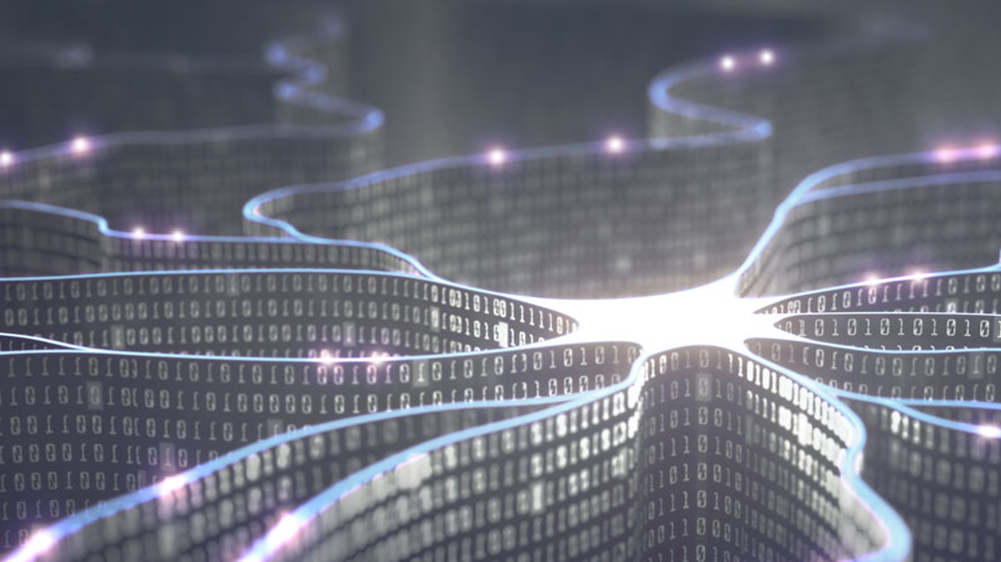
Digital Assistants
how smart apps work and the opportunity for business

Slide 2
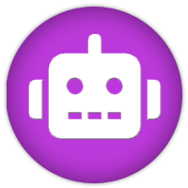





Overview
What is a Digital Assistant?
Digital Assistant Devices
What can Digital Assistants do already?
How do Apps Work?
Will they Change how we Consume the Web?
Consumer Benefits / Business Opportunities

Slide 3
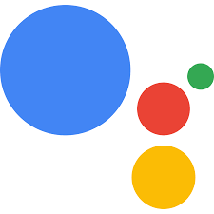

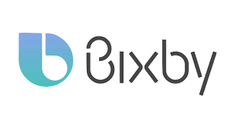
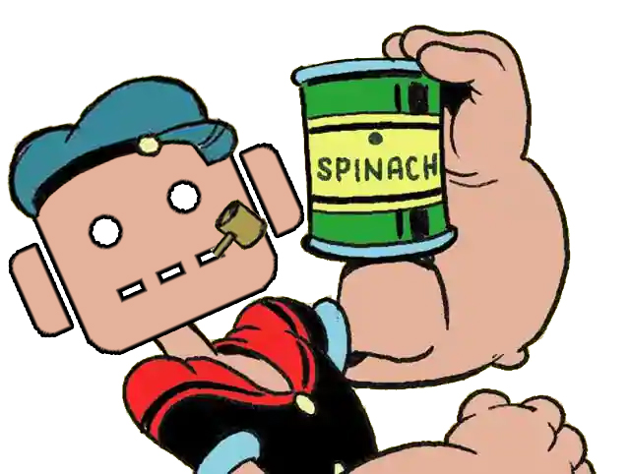
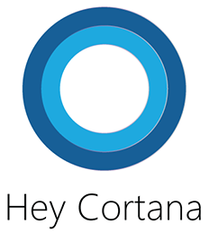
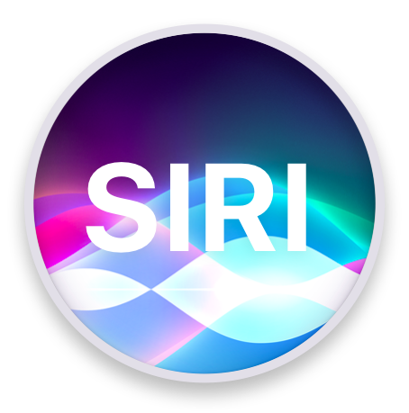
What is a Digital Assistant?
A digital assistant is the name given to a piece of software that interprets natural language input, matches it to an intent and responds by performing tasks associated to the intent.
Notes:
Google Assistant [Focus For Presentation] > DialogFlow - ‘Actions’,
Alexa > Amazon Developer - ‘Skills’,
Bixby > Samsung voice assistant, phones, fridges, Galaxy Home - ‘Capsules’
Cortana – Cortana – ‘Skills / MS Bot Framework’ (Public Preview),
Siri > SiriKit – ‘Shortcuts’ (Not really a Digital Assitant framework)
Think of a Digital Assistant as a Chatbot that’s been eating its Spinach!

Slide 4
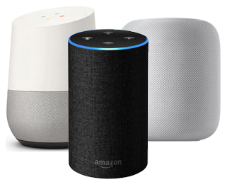
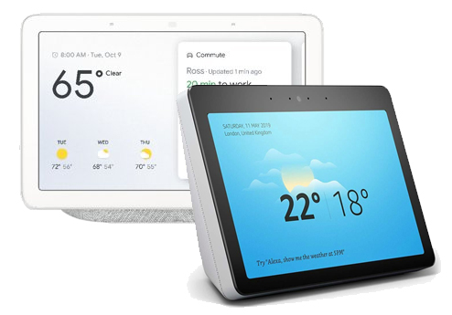
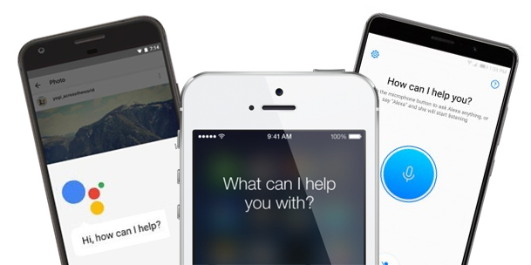
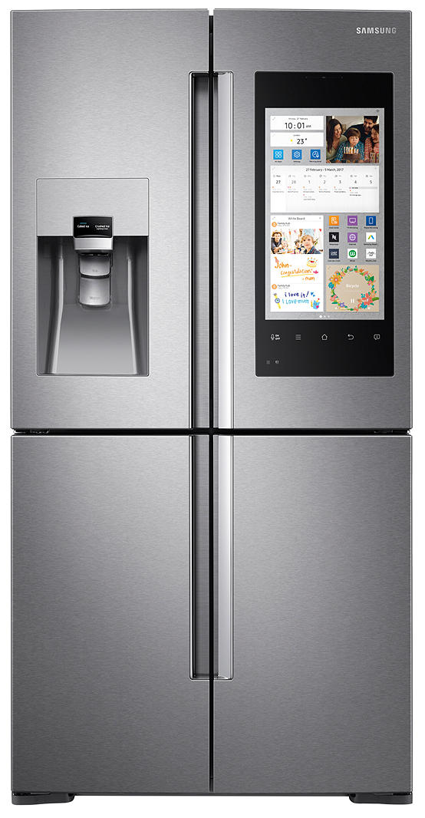
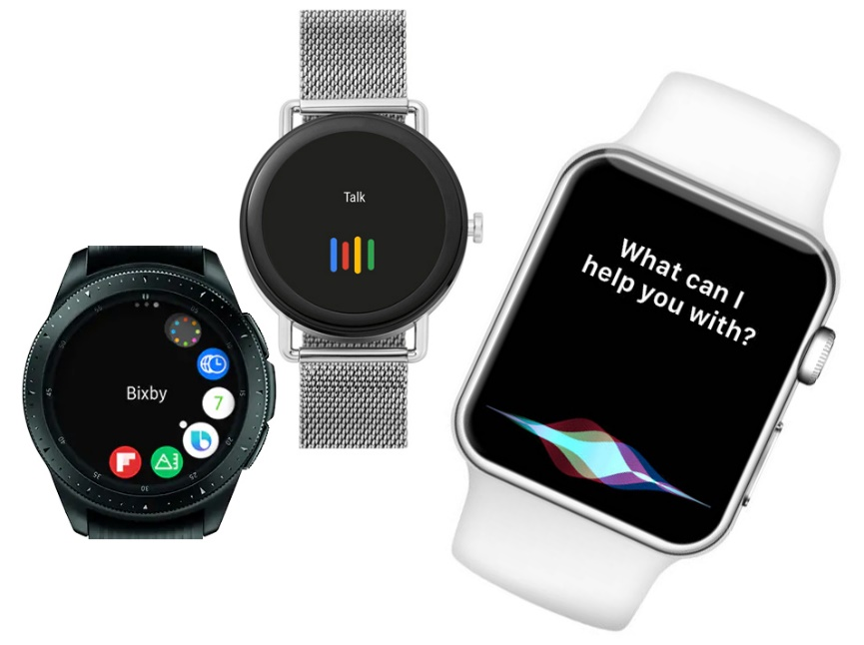
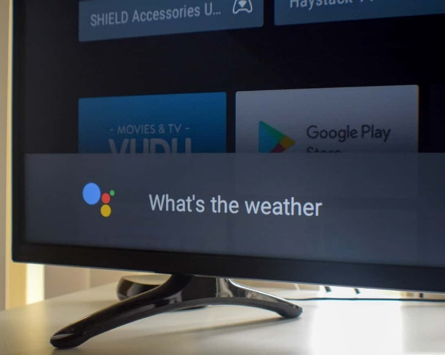
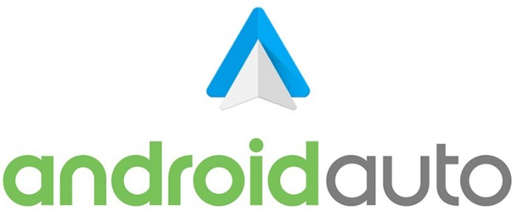
Digital Assistant Devices
Notes:
Smart Speakers > Google Home, Amazon Echo, Apple HomePod, Smart Displays > Google Home Hub, Amazon Echo,
Phones > Android - Google Assistant, Alexa, Cortana, IOS – Siri, Google Assistant, Alexa
Cars – Android Auto, Mercedes Me, Smart Watches > Google Assistant, Siri, Bixby, Smart TVs, TVs > Android TV, LG ThinkQ, Toshiba TV Via Alexa, Smart Fridges > Samsung Bixby

Slide 5
What can Digital Assistants do Already?
answer general knowledge questions
send phone
notifications
order pizza!
recognise multiple family members by voice
deter burglars
get directions
play games
TALK TO BUSINESSES
control heating
change the tv channel
announce who is at the door
send / read texts
remind you
to do things
play
music
turn things
on and off
cast media
tell jokes
vacuum your house
Notes:
Alexa – Burglar Deterrent – Alexa, ask burglar deterrent to protect the kitchen

Slide 6
How do Apps Work?
Focus on google
Two ‘app strands’ – conversational – smart home

Slide 7
How do Apps Work?
DEMO TIME!
Notes:
Before I explain how a Digital Assistant app works, lets have a demo.
Demo > ‘Ok Google, talk to Presentation Helper’ , ‘Show me some bikes’, ‘Show me more on bike 1’, ‘What are the specifications for bike 1’, ‘Yes please (Brochure)’, ‘No thanks’

Slide 8

How do Apps Work?
Ok Google, talk to ‘Presentation Helper’
Notes:
Google Assistant and Amazon Alexa work in the same way.
Google > Uses Google Actions or www.dialogflow.com – NLP / NLU Framework.
Alexa > Uses AWS Developer Skills SDK
Same app can be used on Google Home, Google Assistant, Home Hub. Chatbot, Telephone line, Twitter bot, Facebook chatbot. Basis for Alexa App.
Invocation Phrase – Min two words, but can use one if prove you own brand. Why do people think this phrase might be important?

Slide 9
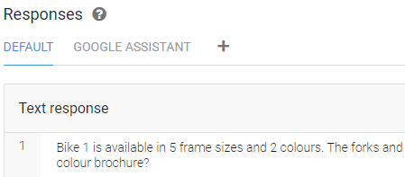
How do Apps Work?
Intents
Entities
Responses
Notes:
Incoming speech is converted to text and then the NLP attempts to match it to an Intent.
An Intent has lots of examples of how the question might be asked – these are used to train the NLP / NLU model.
‘Entities’ can be created and pulled out of the speech – these can be used as parameters to answer a question, i.e. show me ‘bike 1’ or ‘bike 2’
When an Intent is matched, a response in generated which is dependent on the capabilities of the device i.e. Audio Only (Smart Speaker) / Audio & Visual (Smart Display)

Slide 10
How do Apps Work?
Slot Filling
Parameters
Notes:
Where Parameters are not mentioned in the user question then prompts can be defined to fill required parameters (or ‘Slots’)

Slide 11
How do Apps Work?
Context / Follow-up Intents
Bike 1 is available in 5 frame sizes and 2 colours. Would you like a full colour brochure?
Notes:
Follow-up Intents can be ‘chained’ to build more complex, deep conversations using something called ‘Context’. Very powerful and makes the app appear ‘smart’. For example I responded ‘Yes’ to a question I am being asked, but how does it know what I am saying yes to? > Context

Slide 12

How do Apps Work?
“Intent” : “Question_BikeSpecs”
“User Utterance” : “Specs for Bike 1”
“Parameters” : [{“BikeModel” : “Bike 1”}]
Notes:
Most Digital Assistant apps back onto a web service (https endpoint).
The NLP passes the service a Json package the includes the Intent fired + Confidence Score + User Utterance + Parameters
Service looks up an answer and passes a Json bundle back as response to the client device

Slide 13
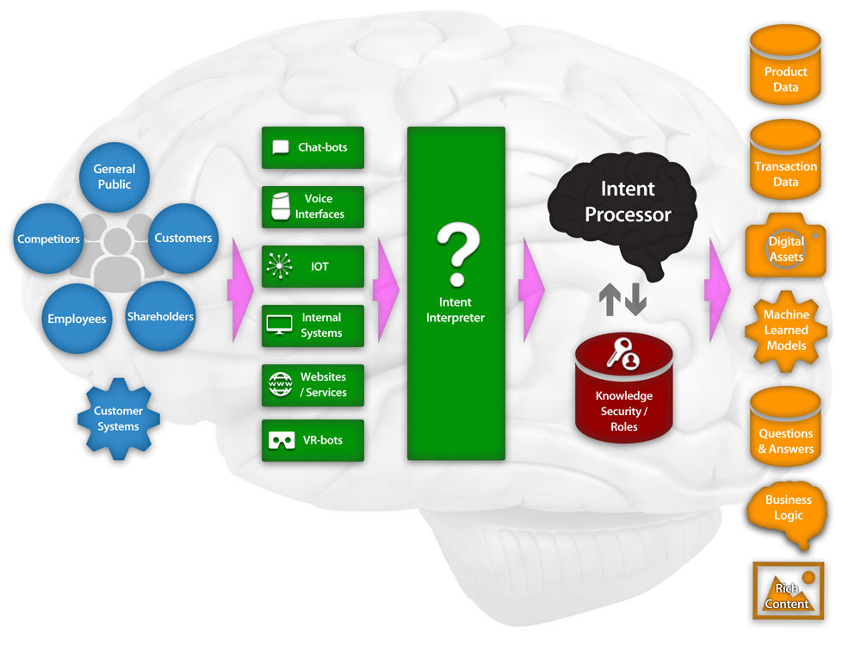
How do Apps Work?
Scaling Up for Enterprise
A Business BrAIn
+ Smart Displays
+ Smart TVs
+ Virtual Call Centre
Notes:
Scaling up this approach for Enterprise we have the Business Brain or Knowledge Framework. A method of ‘Talking’ to an organisation via a single Service.
Very fast moving sector, both Google and AWS already allow you to plug their Call Centre Software into these frameworks.
Use same approach for Chatbot, Digital Assistant, Personal Assistant, Virtual Agent

Slide 14
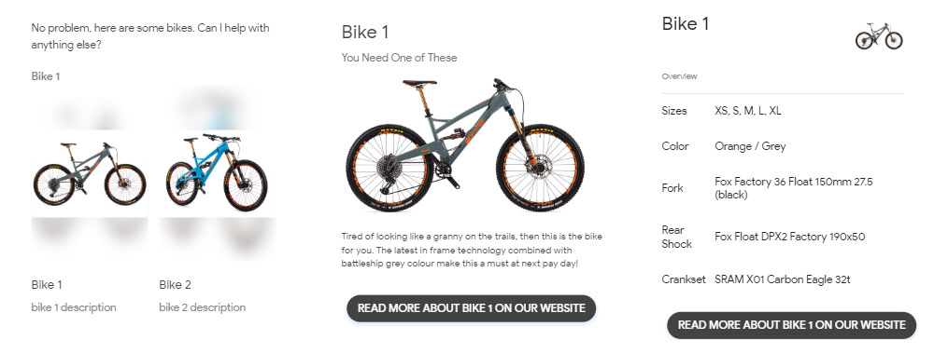
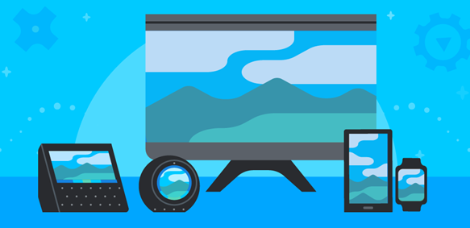
Could DAs Change how we Consume the Web?
Notes:
Are we moving towards a bite-sized web? Could websites become the ‘traditional’ way of browsing content.
Alexa have ‘APL’ – Alexa Presentation Language, which will shortly include HTML 5.
Google via DialogFlow have approx. 10 controls i.e. Image Cards, Carousels, Chips, Audio etc

Slide 15
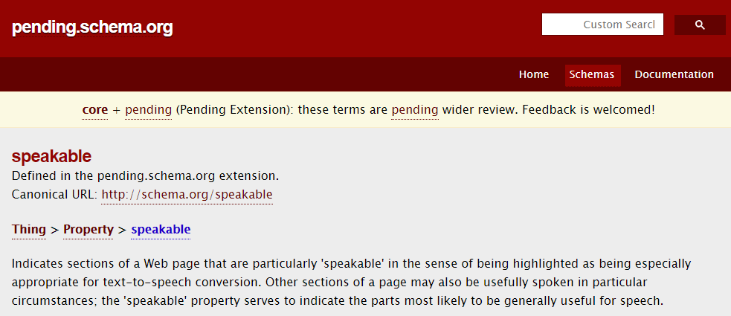
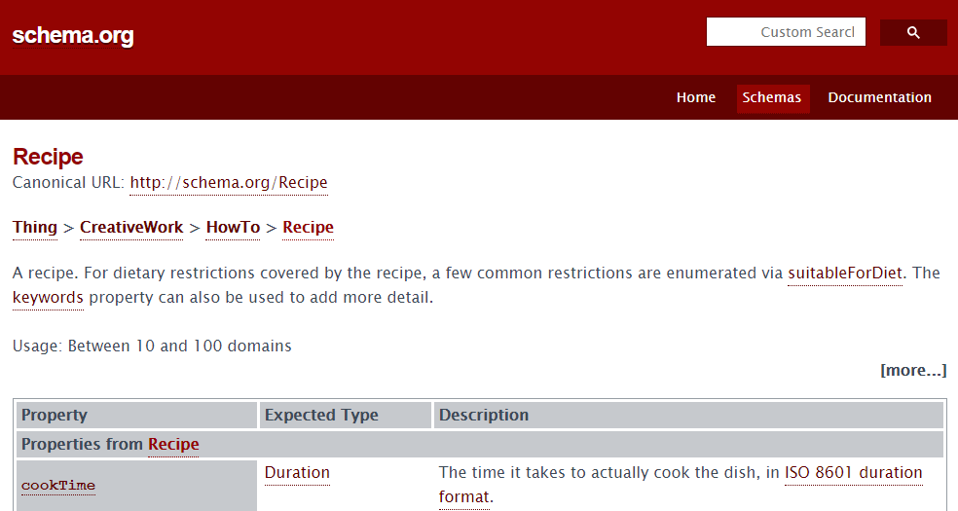
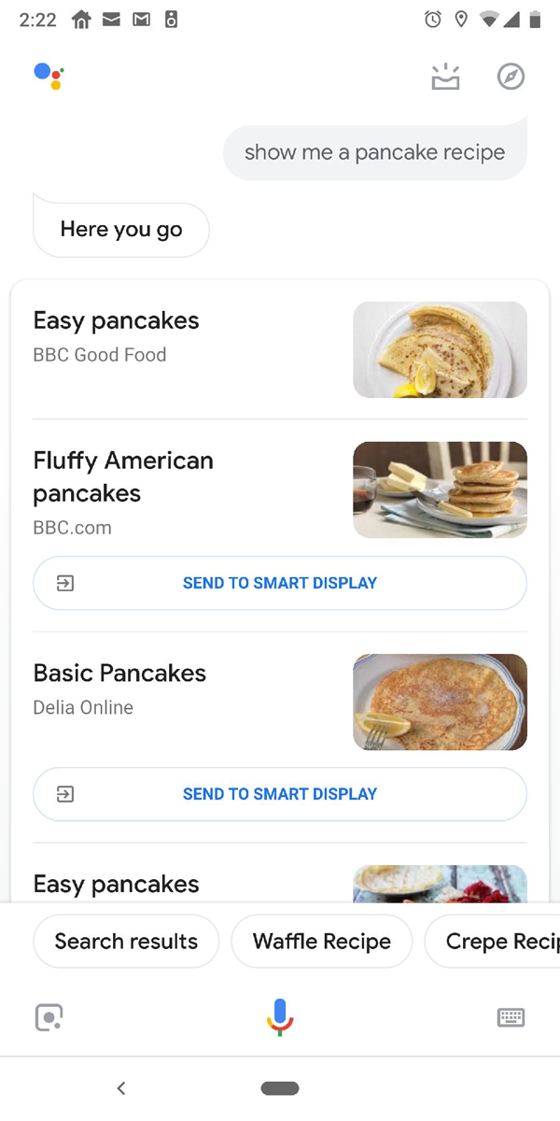
Could DAs Change how we Consume the Web?
Notes:
Google are using Schema.org markup to pull content through into smart displays and smart speakers

Slide 16
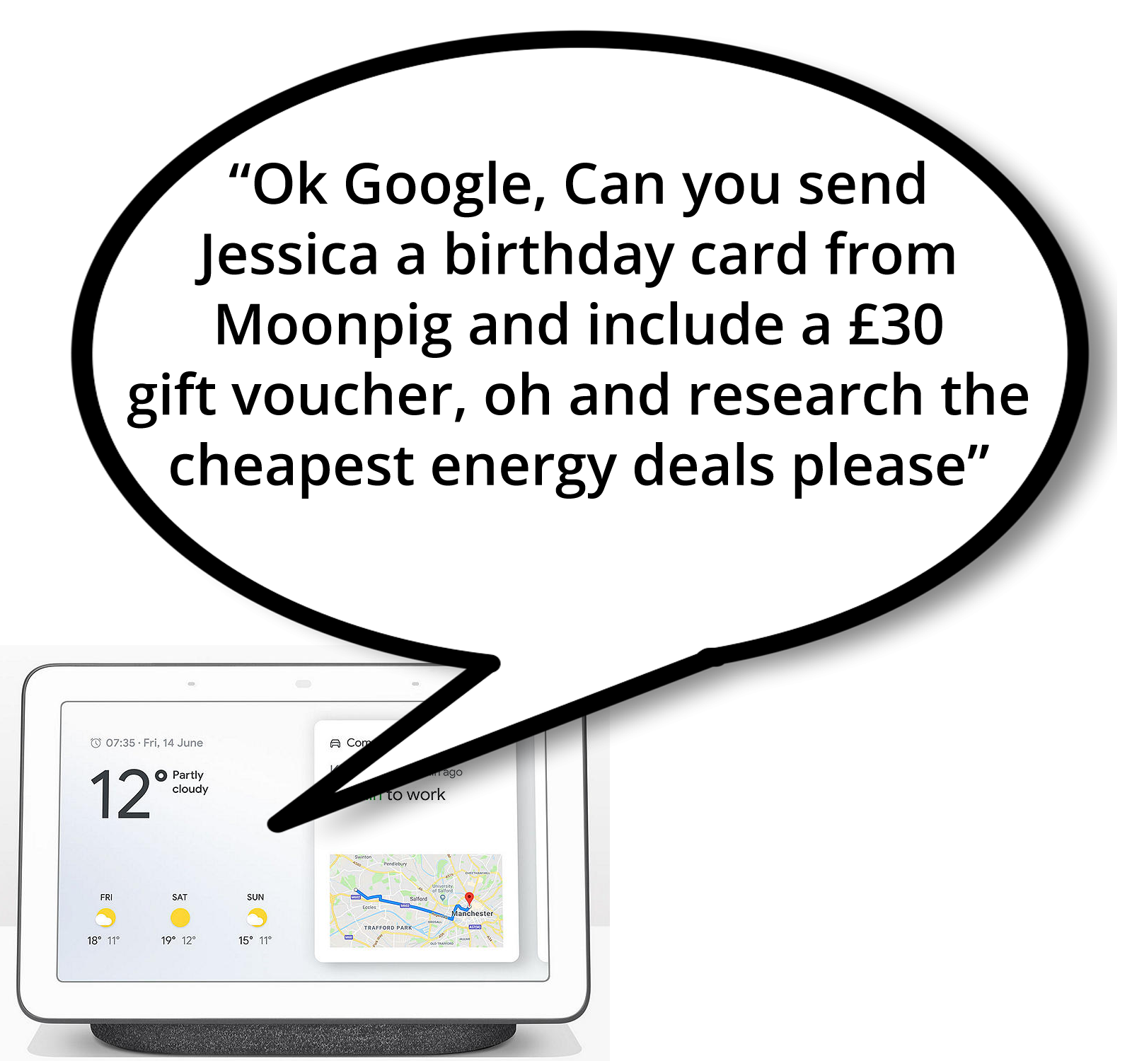
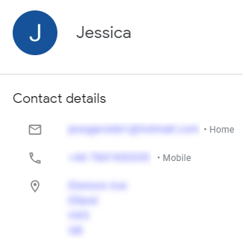
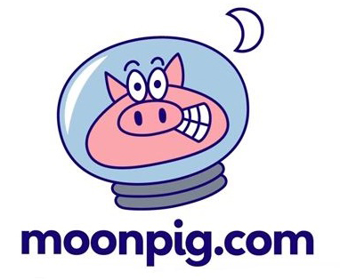
Could DAs Change how we Consume the Web?
Notes:
Google already recognises my voice and knows its me.
It knows who Jessica is from my Contacts + het Address.
My payment details are already with Google
This command links deep into the Moonpig Voice App and shows me a selections of cards.
I select one and the transaction is complete – not a website in sight!

Slide 17
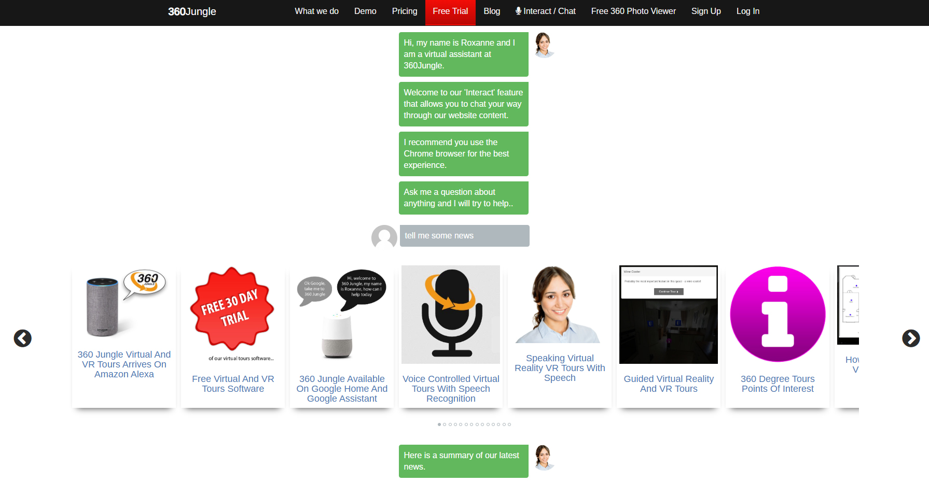
Could DAs Change how we Consume the Web?
Notes:
‘Interactive Websites’ can be built using Dialogflow – ‘Chunks’ of content are pulled into an Interactive Website feature giving a completely personalised experience.

Slide 18

Could DAs Change how we Consume the Web?
What Steps can Businesses Take Now?
Get a Presence > Secure Your Invocation Phrase
Familiarise IT teams with NLP / Brain Frameworks
Ensure all your web content has schema.org markup
Get a device and use it! > Identify the Opportunities
Think how to Serve Bite Sized Content

Slide 19
Consumer Benefits / Business Opportunities
Consumers Communicate 24/7 - 365
Ability to Talk to
Your Organisation
Positioned for Early Adoption of Virtual Call Centre Tech
BrAIn > One Framework – Multi Channel
Prepared for
Bite-sized Web
Brand Security
Consistent CTAs
Sentiment Analysis
Internal Assistant > Reduced Training
Increased Productivity
Consistent Responses
Increased Contact Surface
Low Running Costs with High Availability / Scalable
Notes:
Increased Consumer Contact Surface > 10’s of millions of devices with digital assistants on them.
Sentiment Analysis > Packages like Dashbot.Io plug straight in and give sentiment analysis etc out of the box.
24 / 7 – 365 Availability > Always on.
Brand Security > There is a gold rush coming!
BrAIn > One Framework – Multi Channel

Slide 20
Digital Assistants
https://www.stephengarside.co.uk/da

