Slide 1



Slide 2
are you building your business brAIn?

Slide 3
Overview
What do we mean by business brAIn?
Who will use your business brain?
How do we connect to it?
The Intent Interpreter
Intent Processing
What about ‘Knowledge Security’?
What do you feed it?
A brAIn in action…
Analysing throughput
Business benefits

Slide 4
What do we mean by business brAIn?
“a knowledge architecture that securely interprets and distributes business intelligence to people, software and IOT”

Slide 5
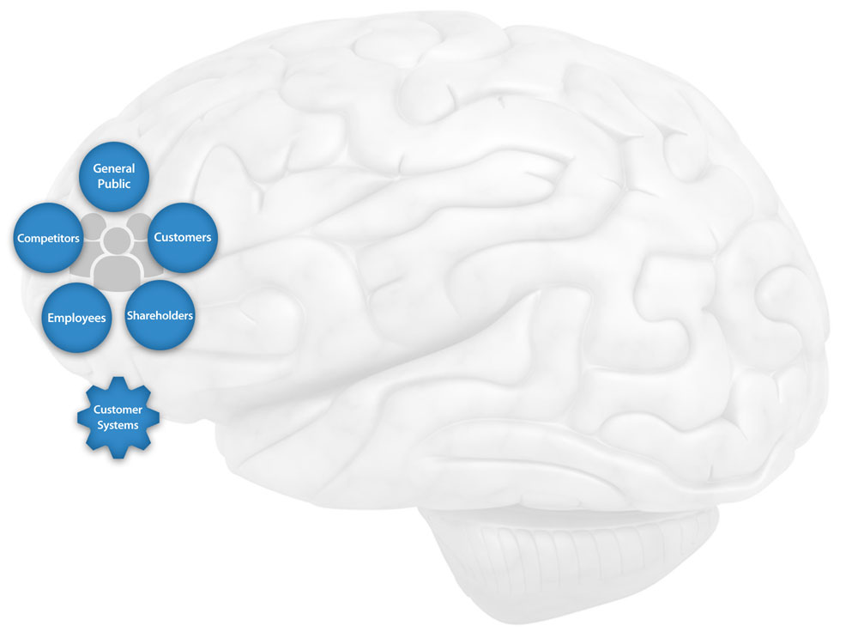
Who will use your business brain?

Slide 6
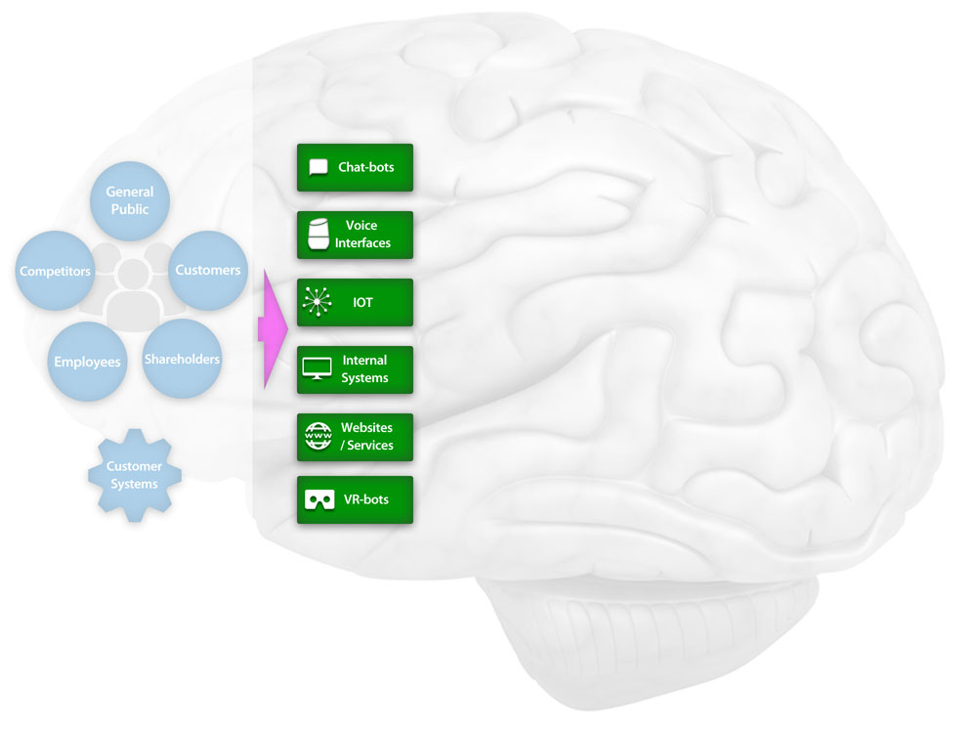
How do we connect to the brain?

Slide 7
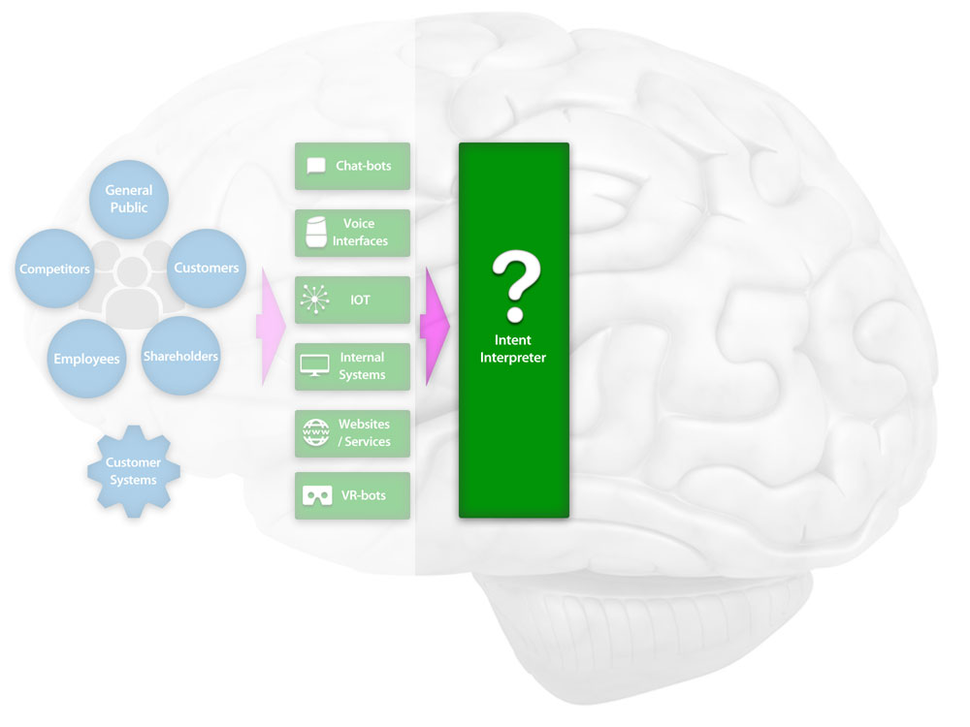
The Intent Interpreter

Slide 8

The Intent Interpreter
“understanding intent is everything!”

Slide 9
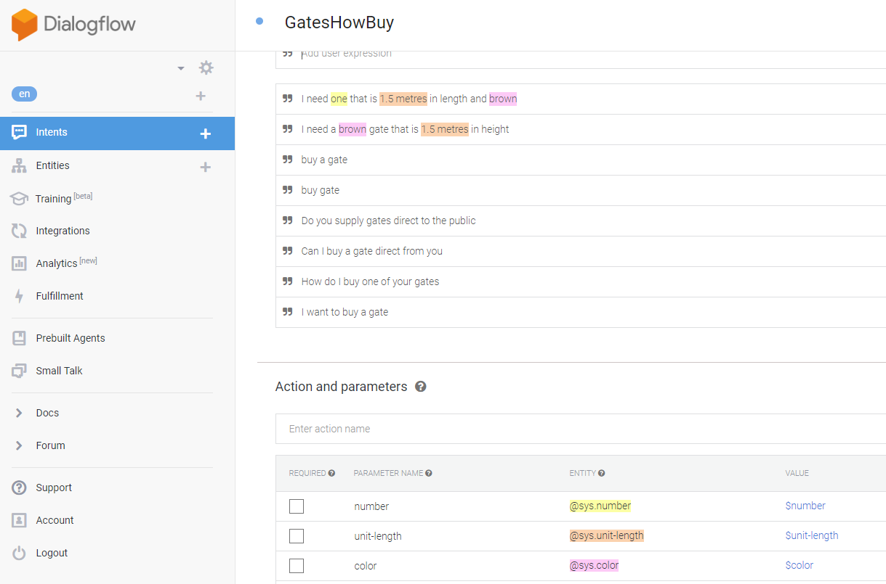
The Intent Interpreter

Slide 10
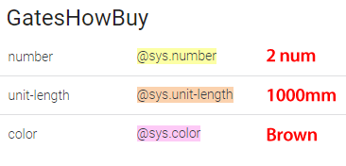

The Intent Interpreter

Slide 11
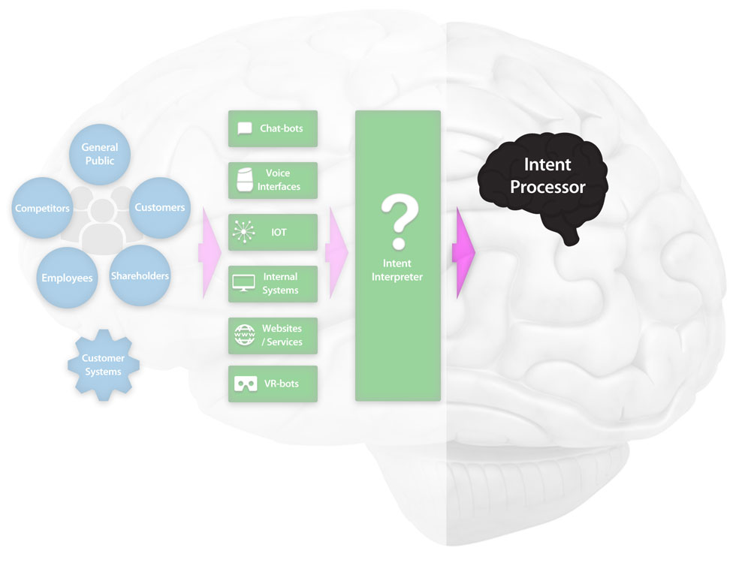
Intent Processing

Slide 12
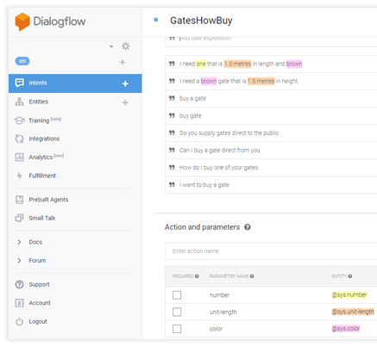

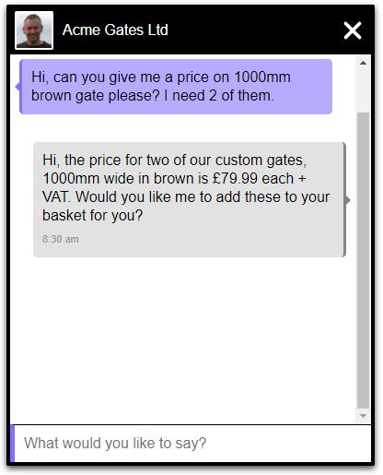
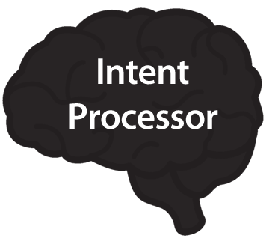

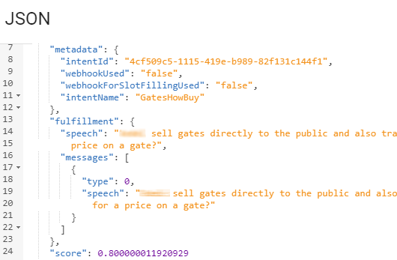
Intent Processing

Slide 13
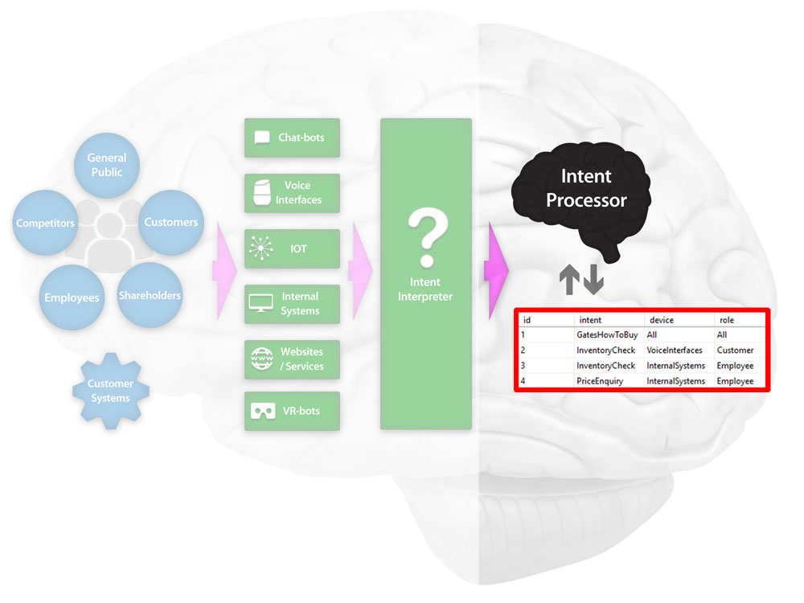
What About Knowledge Security?

Slide 14
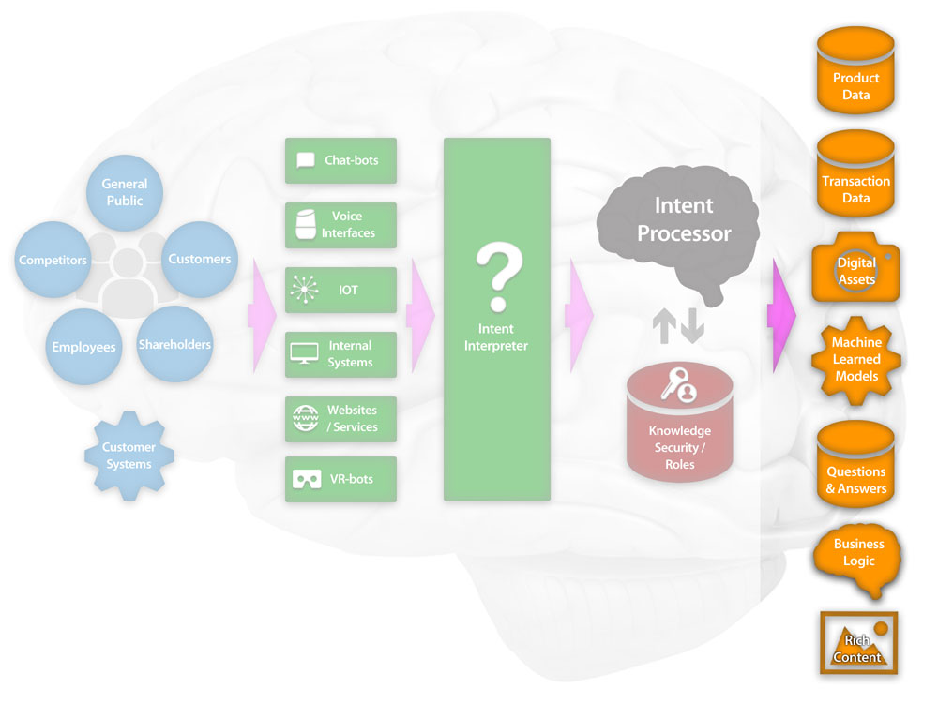
What Do You Feed Your BrAIn?

Slide 15
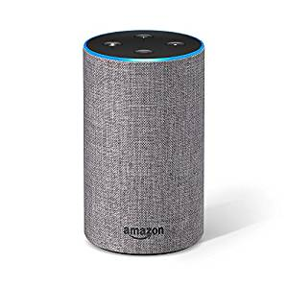
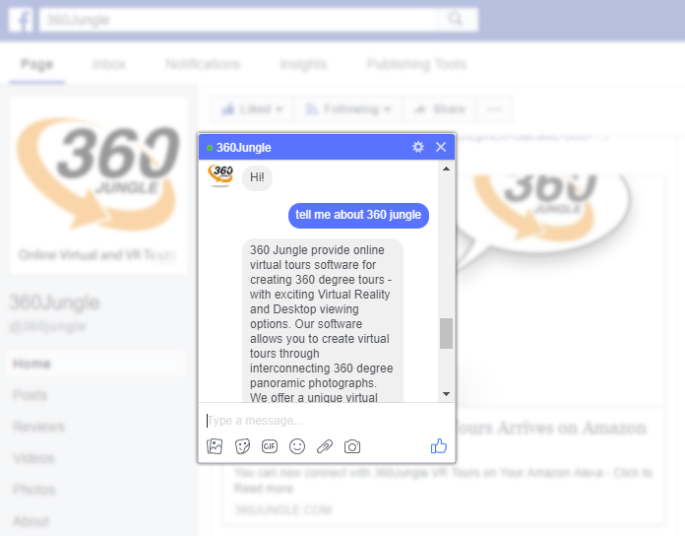
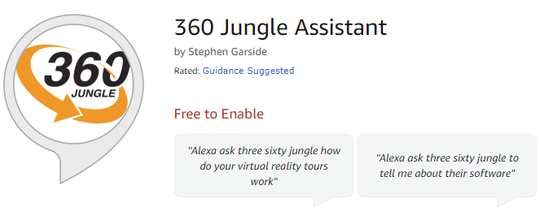
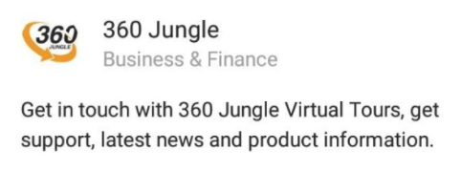

A BrAIn in Action

Slide 16
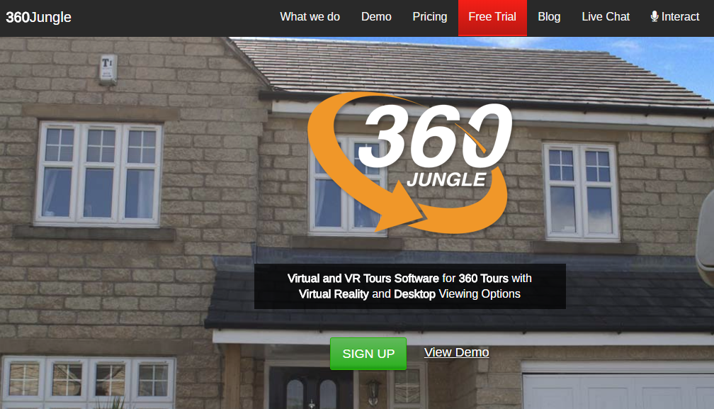
A BrAIn in Action
https://www.360jungle.com/interact

Slide 17
A BrAIn in Action
Tell me about product x?
Can I get a price for service y?
How much inventory do you have of product y
What delivery options do you offer?
Show me pictures of product x in colour y
How do I install product x
Tell me your latest news
How does service x compare to service y
How do I process this type of transaction?
What were the sales of x yesterday?

Slide 18
Business Benefits
Cost savings - reduced staffing levels
All enquiries answered – 24/7 availability & infinitely scalable
Increased customer satisfaction – provision of consistent, and instant information
Superior focus on customer experience pain points - retrospective intent analytics
Increased contact surface - Google Home / Assistant, Alexa etc
Improved lead generation - consistent CTA behaviour
Secured business knowledge - employee churn
Faster staff training – instant, easy access to consistent knowledge
Reduced capital outlay over time - extensible ‘bolt on’ framework that covers ANY business discipline
Positions business for early tech adoption - new telephone > bot tech, interactive websites, voice driven interactive VR / AR

Slide 19
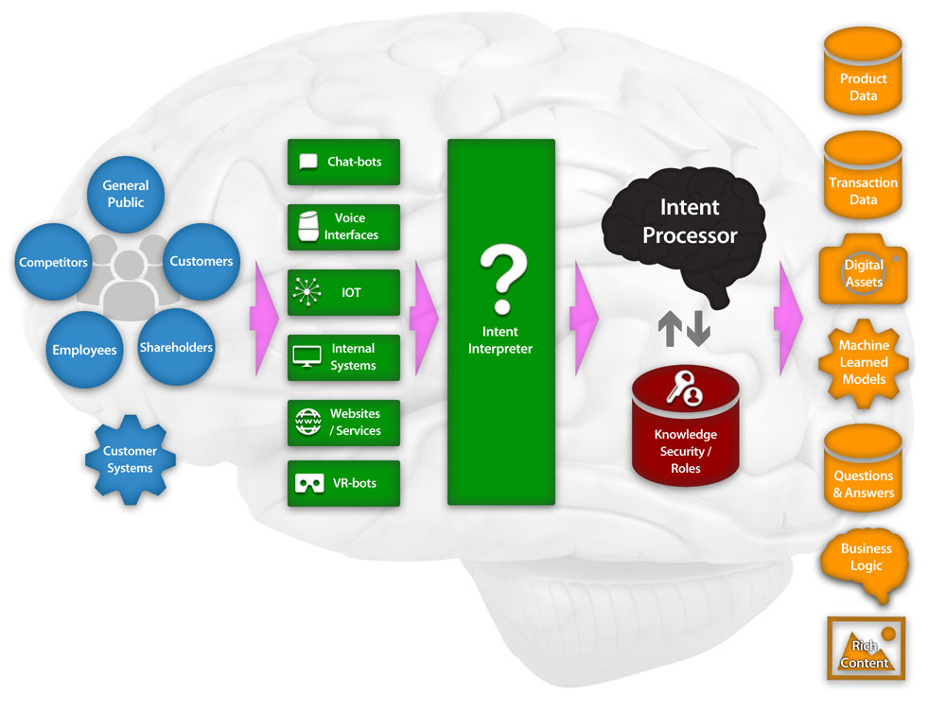
“a knowledge architecture that
securely interprets and distributes
business intelligence
to people, software and IOT”

